Slide 1





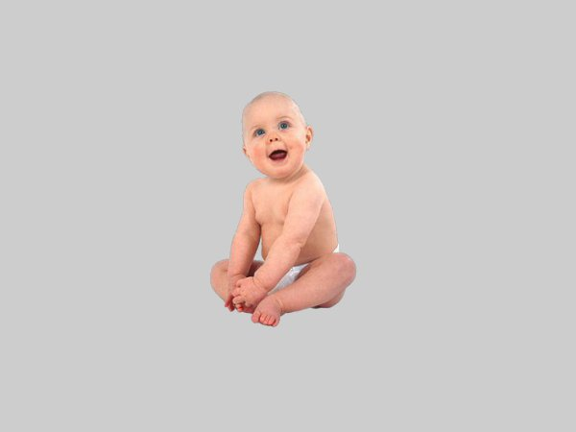
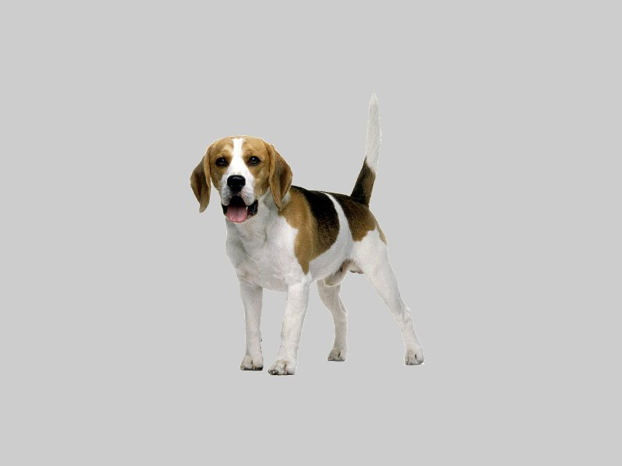
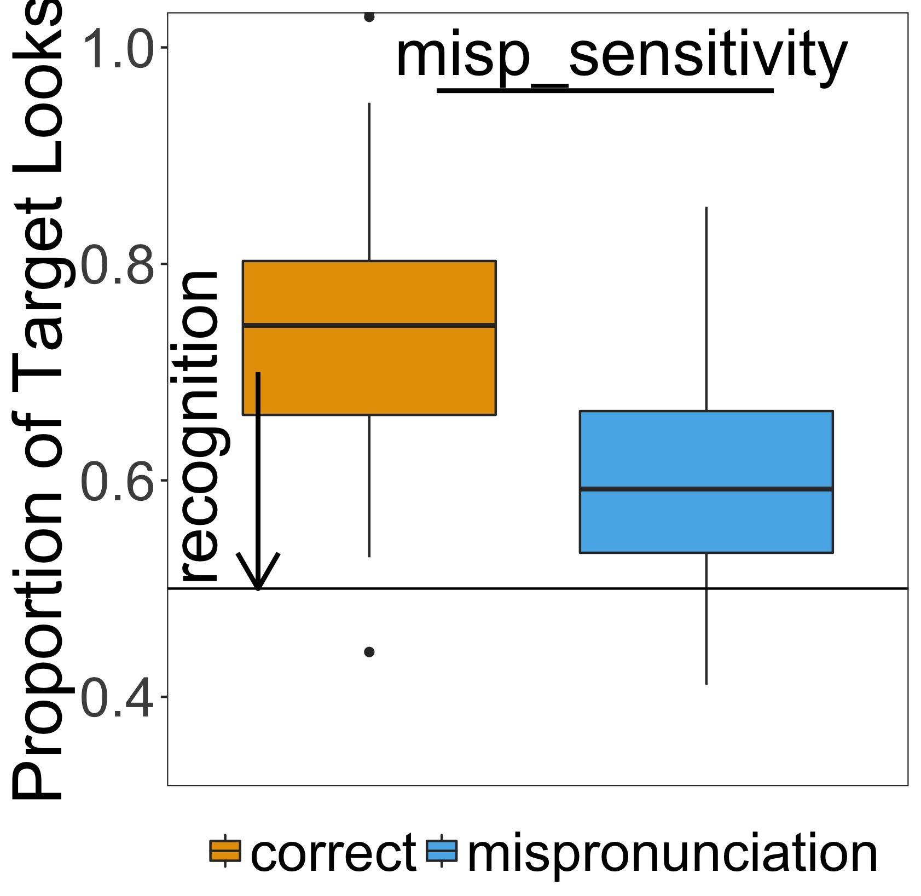
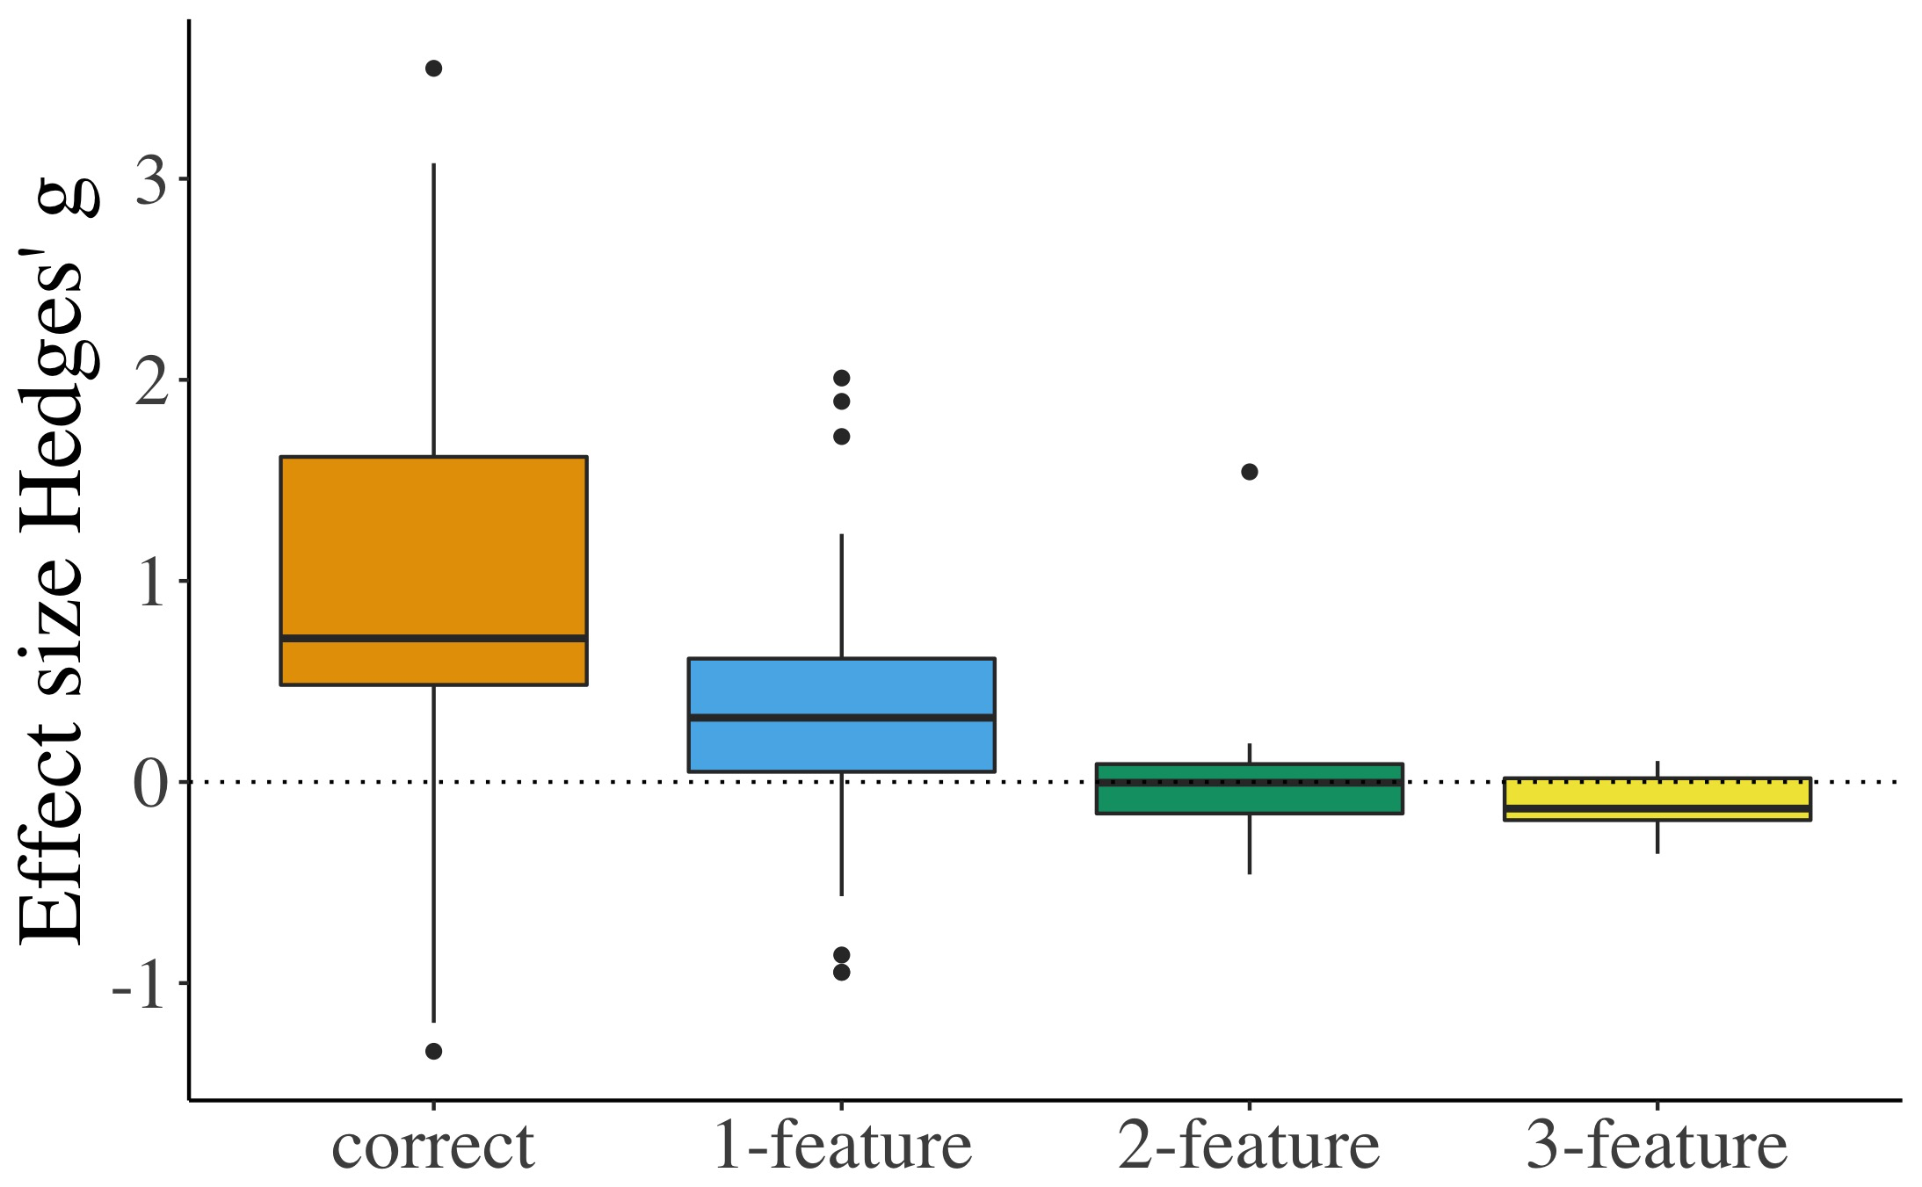
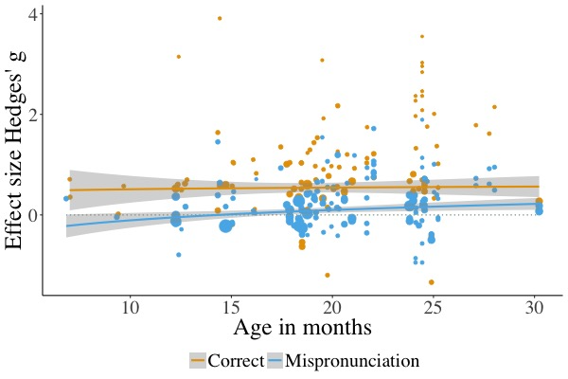
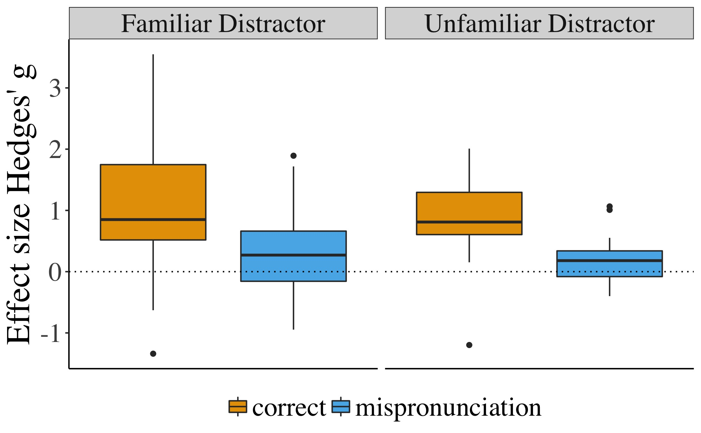
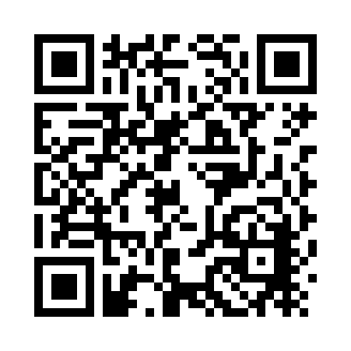

A meta-analysis of mispronunciation sensitivity in infancy
Katie Von Holzen^{1,2} & Christina Bergmann^{3,4}
University of Maryland, USA
2. Université Paris Rene Descartes, Laboratoire de Psychologie de la Perception CNRS, France
3. Max Planck Institute for Psycholinguistics, The Netherlands
4. LSCP, Département d'Etudes Cognitives, ENS, EHESS, CNRS, PSL Research University
Mispronunciation Sensitivity
Infants’ sensitivity to changes in the phonological form of familiar words
Database Information
32 papers (mostly journal articles)
249 unique experimental conditions
2252 infants
6 to 31 months
Participants | Stimuli | Procedure | Results
Age in days | # features | # trials | DV type
Sample size (n) | Change position | Distractor familiarity/overlap | vocabulary
Native Language | Consonant/vowel |  | misp sensitivity
Dog
Tog
Does the number of phonological features changed modulate mispronunciation sensitivity?
How does mispronunciation sensitivity change as infants develop?
More sensitive with development¹
Less sensitive with development²
No change in sensitivity with development
Features
1: g = -0.51, SE = 0.04, p < .0001
2: g = -0.48, SE = 0.07, p < .0001
3: g = -0.69, SE = 0.10, p < .0001
Interactions with Age
No significant interactions with Age
Sensitivity to mispronunciations increases as the number of features changed increases
Stays consistent as infants age
*Focus on ages where feature manipulated*
Does familiarity with the distractor image modulate mispronunciation sensitivity?
Distractor Familiarity
Sensitivity: g = 0.19, SE = 0.09, p < .05
Interactions with Age
No significant interactions with age
Mispronunciation sensitivity greater when the distractor is unfamiliar
Stays consistent as infants age
*Focus on ages where familiar and unfamiliar distractors used*
Correct
Recognition: g = 0.91, SE = 0.12, p < .0001
Mispronunciation
Recognition: g = 0.25, SE = 0.06, p < .0001
Correct vs. Mispronunciation
Sensitivity: g = .5, SE = 03, p < .0001
Interactions with Age
No significant interactions with Age
Sensitivity to mispronunciations stays consistent as infants age (Theory 3)
References
Werker, J. F., & Curtin, S. (2005). PRIMIR: A Developmental Framework of Infant Speech Processing. Language Learning and Development, 1(2), 197–234
Best, C. T. (1994). The emergence of native-language phonological influences in infants: A perceptual assimilation model. Haskins Laboratories Status Report on Speech Research
What’s in your File Drawer?
Do you have a mispronunciation study that is unpublished?
Add it to our meta-analysis!
Contact: Katie Von Holzen (katie.m.vonholzen@gmail.com) & Christina Bergmann (chbergma@gmail.com)

